Slide 1
OpenSSH
Lecturer: Ngo Huy Bien
Software Engineering Department
Faculty of Information Technology
VNUHCM - University of Science
Ho Chi Minh City, Vietnam
nhbien@fit.hcmus.edu.vn

Slide 2

Objectives

Slide 3

Contents

Slide 4

References

Slide 5
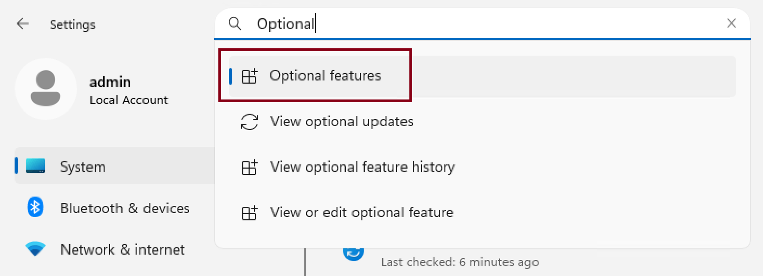
1. Open Optional features

Slide 6
2. Install OpenSSH Server
Install OpenSSH Server
Open Services.
Start OpenSSH SSH Server service.
Start OpenSSH Authentication Agent service.
Open Firewall port 22.

Slide 7
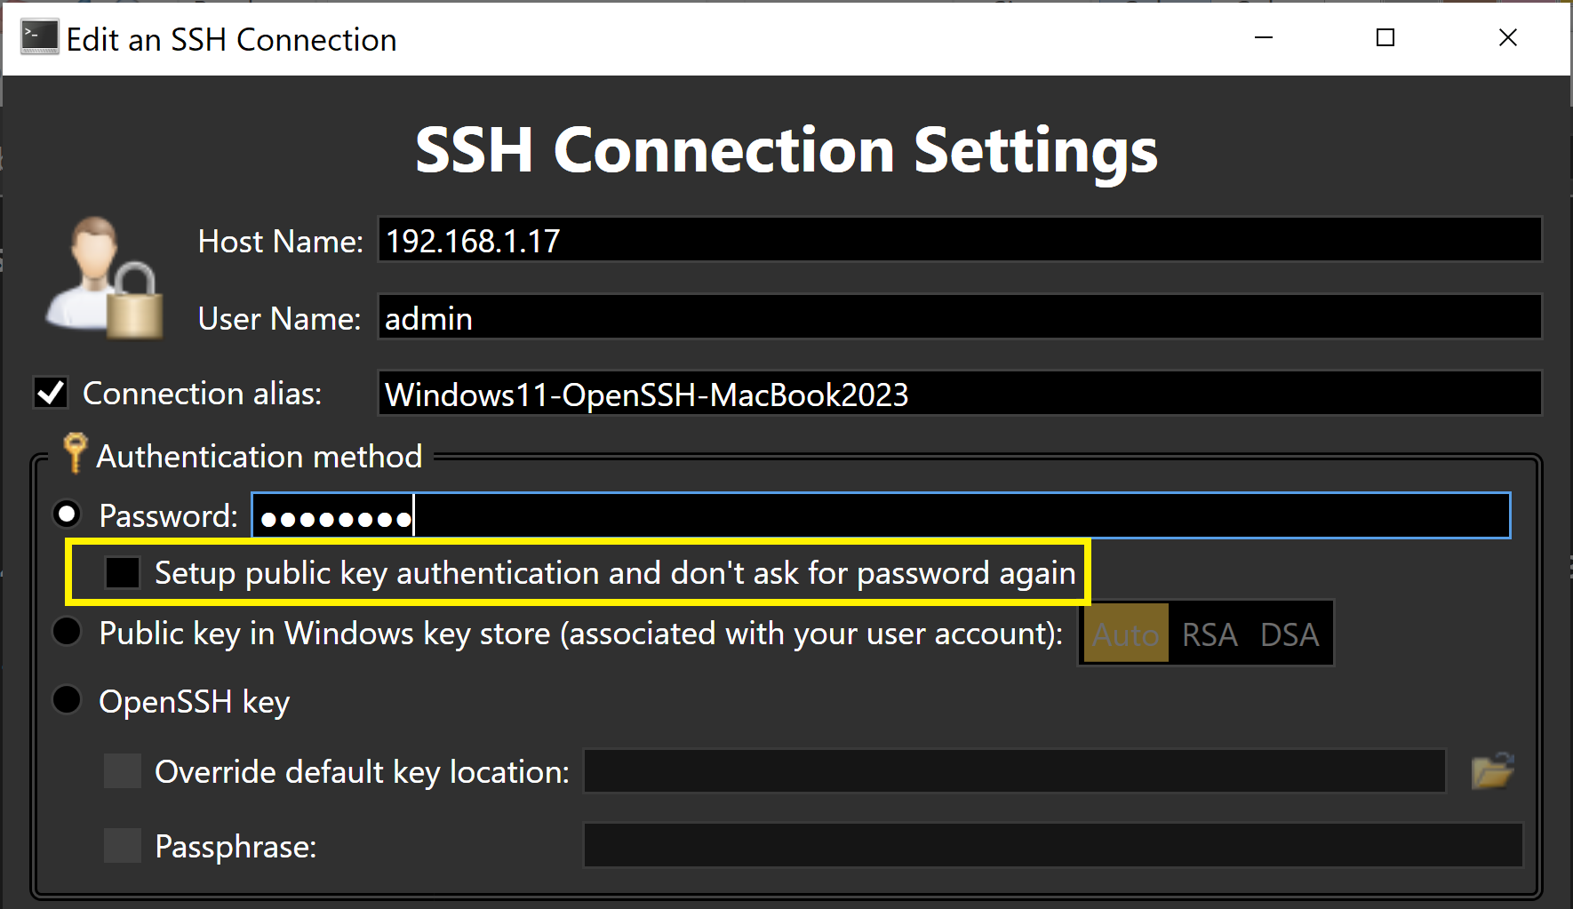
3. Create SSH Connection
Do not set up public key.

Slide 8
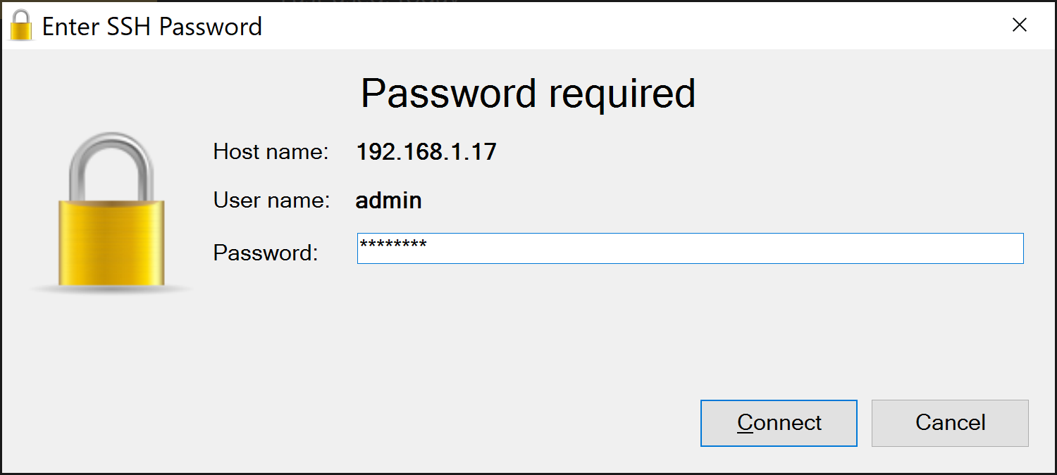
4. Connect to the SSH Server
shutdown /s /t 0
shutdown /r /t 0

Slide 9

Thank You & See You Again

